Slide 1
THE CIBIL SYSTEM PROJECT
Done BY
CHALLA JYOTHISWAR -RA1911003010914
B . SAI NATHA -RA1911003010912
G . SAI NANDA -RA1911003010916
Reference: https://cleartax.in/s/cibil

Slide 2


Slide 3
PROBLEM STATEMENT
In the present system a user can be reminded with the calculated CIBIL score based on the repayment of the loans that the user availed. This often requires a lot of time and effort as it a manual system of the admins. A customer may not get the desired information from these offices and often the customer may be misguided. It is tedious for a user to get a proper guidance to repay the loan due.
Our proposed system is a web based automated application and maintains a centralized repository of all related information. The system maintains the records of the loan details for every user. Also it calculates the CIBIL score known as credit score based on the repayment ability of the user. On a regular basis it notifies the users to pay their loan amount. If the user didn’t pay their loan amount it will recommend them the Job offer to help them maintain the credit score.

Slide 4
REQUIREMENTS

Slide 5
PROJECT SCOPE:
The scope is simply all the work that needs to be done in order to achieve a project's objectives. In other words, the scope involves the process of identifying and documenting specific project goals, outcomes, milestones, tasks, costs, and timeline dates specific to the project objectives.
IN SCOPE
Unlimited access-Get regular updates to your CIBIL Score & Report.
Alerts-Get instant alerts whenever there are any changes in your credit profile!
OUT OF SCOPE
• Sanctioning of Loan to the user
• Direct Payment of the Installments

Slide 6
FUNCTIONAL REQUIRMENTS
These are the requirements that the end user specifically demands as basic facilities that the system should offer.
When the user enters the information, the system shall send an approval request..
The system shall only allow managers to view customer banking data.
NON-FUNCTIONAL REQUIREMENTS
These are basically the quality constraints that the system must satisfy according to the project contract.
They basically deal with issues like:
Portability ,Security ,Maintainability ,Reliability ,Scalability ,Performanc,e Reusability ,Flexibility
• Employees never allowed to update their salary information. Such attempt should be reported to the security administrator.
• Every unsuccessful attempt by a user to access an item of data shall be recorded on an audit trail.

Slide 7
INFRASTRUCTU REQUIREMENTS
Hardware Requirements:-
PROCESSOR : Intel Pentium IV 1.8 GHz
MOTHERBOARD : Intel 915GVSR chipset board
RAM : 1 GB DDR2 RAM
HARD DISK DRIVE : 160 GB
MONITOR : 17” Color TFT Monitor
KEYBOARD : Multimedia Keyboard 108 Keys
MOUSE : Logitech Optical Mouse
PRINTER : Multi functional printer
Software Requirements: -
Front End: HTML5, CSS3, Bootstrap
Back End: PHP, MYSQL
Control End: Angular Java Script
Android Tools:
xampp-win32-5.5.19-0-VC11 , Note Pad ++ , Star Uml.

Slide 8
DESIGN

Slide 9
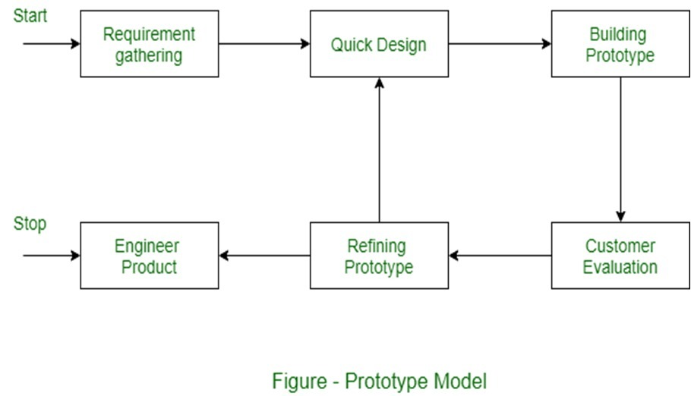
DESIGN TECHNIQUE
We have choosen PROTOTYPE Model . This model works very good in the situation where the project’s requirements are not known in detail. So it is an iterative model which takes between user and developer.

Slide 10
UML DIAGRAMS:
UML stands for Unified Modeling Language. UML is a language for specifying, visualizing and documenting the system. This is the step while developing any product after analysis. The goal from this is to produce a model of the entities involved in the project which later need to be built. The representation of the entities that are to be used in the product being developed need to be designed.
There are various kinds of methods in software design:
Use case Diagram
Sequence Diagram
Collaboration Diagram
Architecture

Slide 11
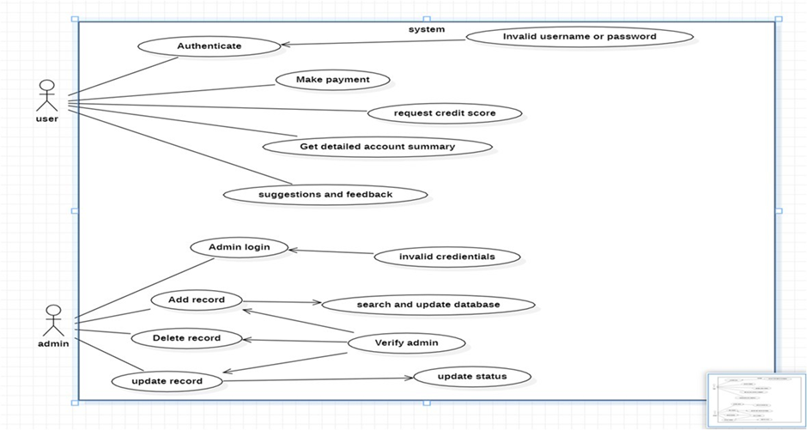
USE CASE DIAGRAM

Slide 12
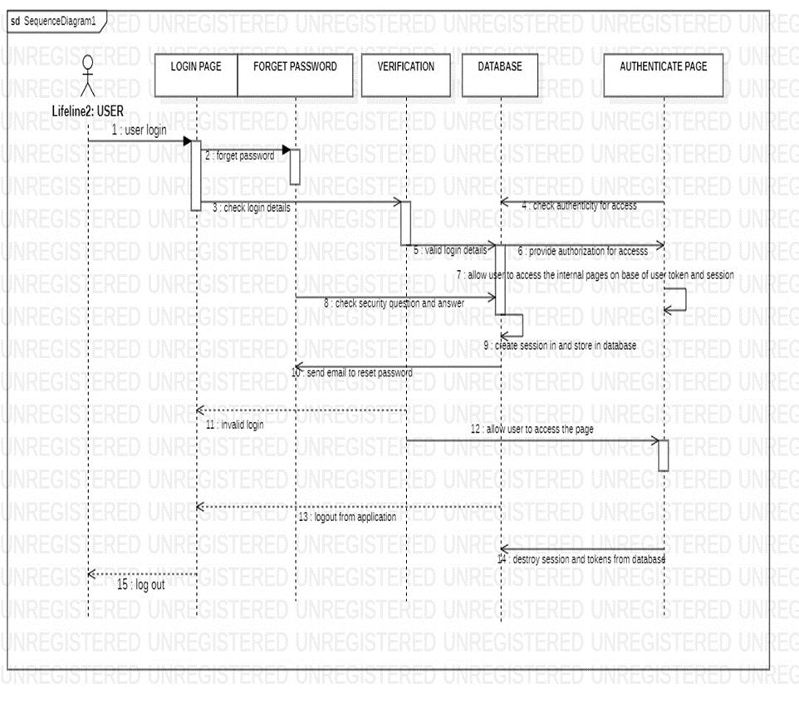
SEQUENCE DIAGRAM

Slide 13
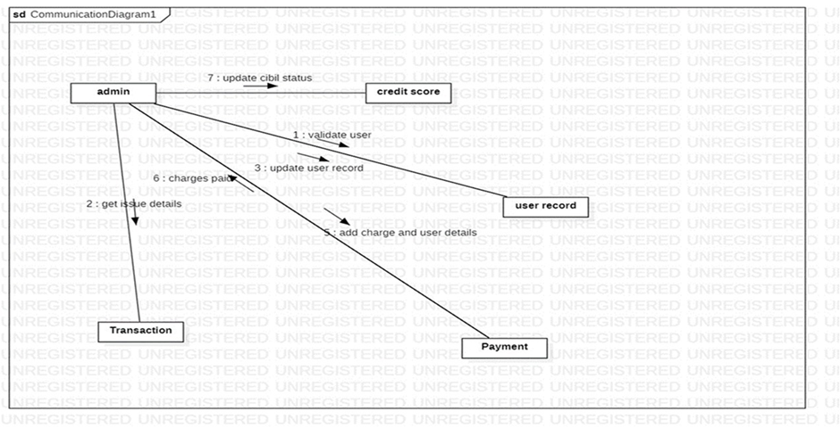
COLLABORATION DIAGRAM

Slide 14
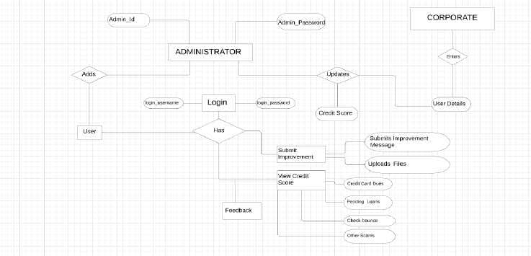
ARCHITECTURE DIAGRAM

Slide 15
MODULE DESCRIPTION

Slide 16
In the life of the software development, problem analysis
provides a base for design and development phase. The problem is analyzed so that sufficient matter is provided to design a new system. Large problems are sub-divided into smaller once to make them understandable and easy for finding solutions. Same in this project all the task are sub divided and categorized.

Slide 17
MODULE 1

Slide 18
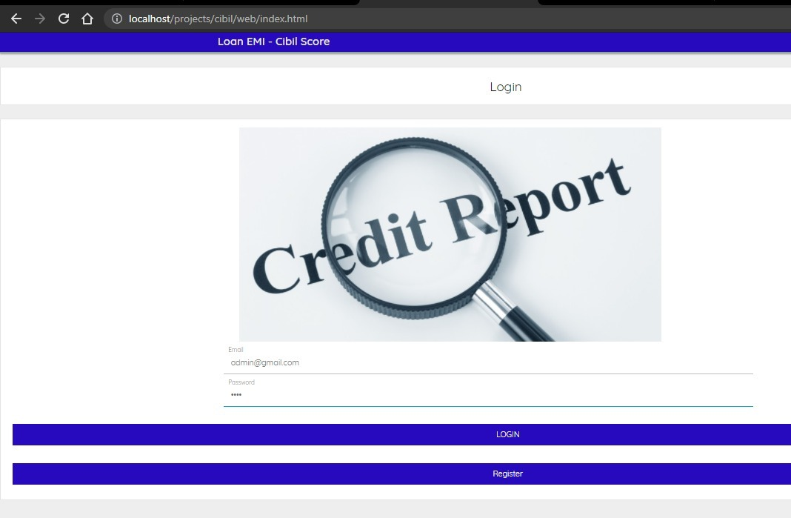

Slide 19
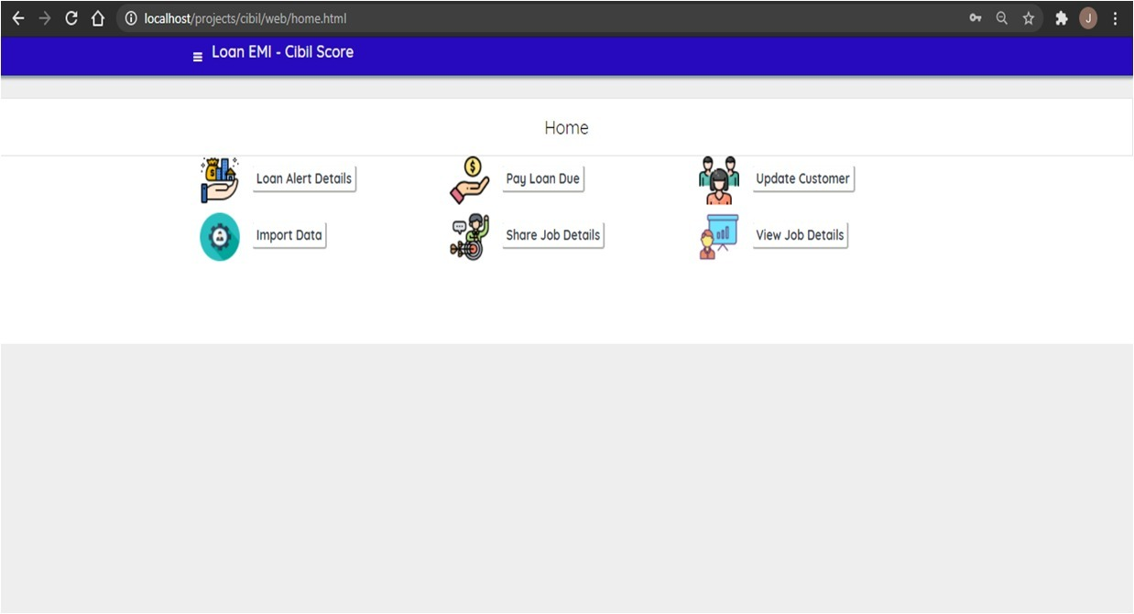

Slide 20
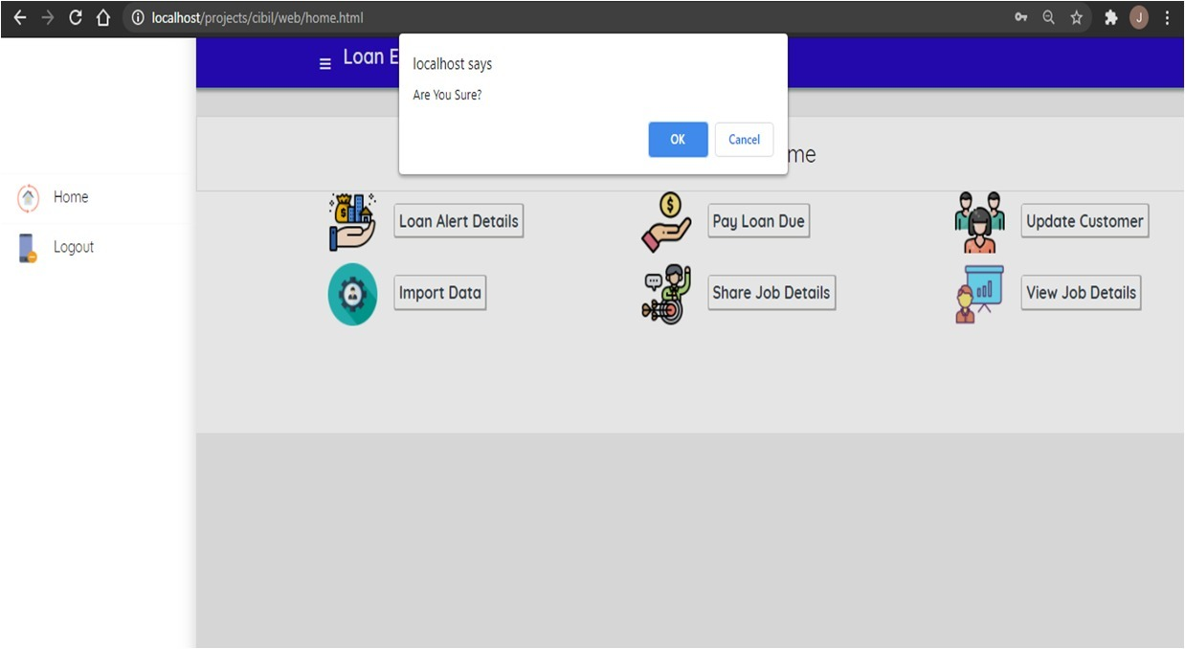

Slide 21
MODULE 2

Slide 22
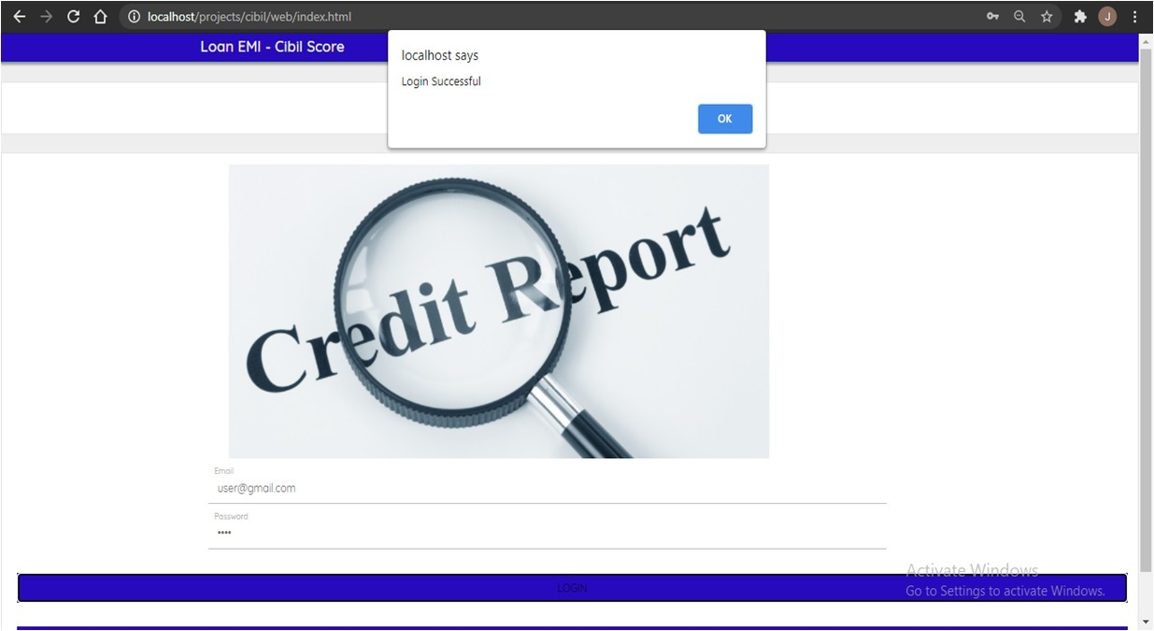

Slide 23
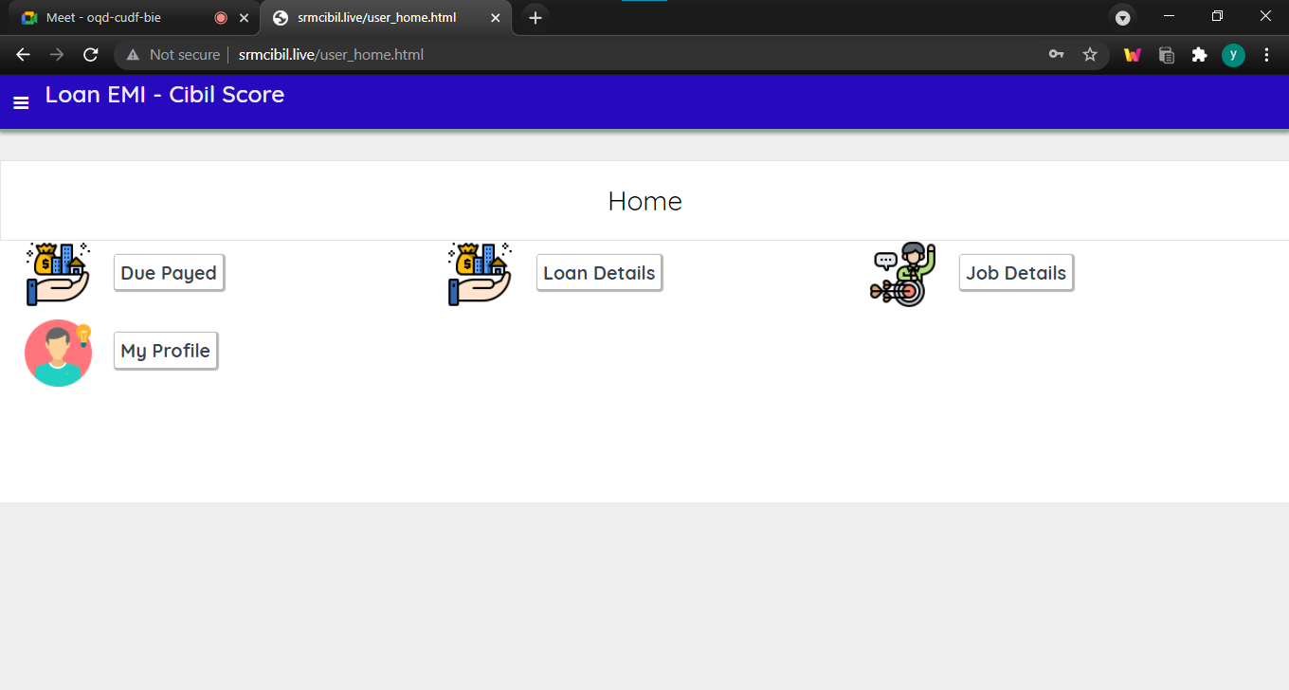

Slide 24
MODULE 3

Slide 25
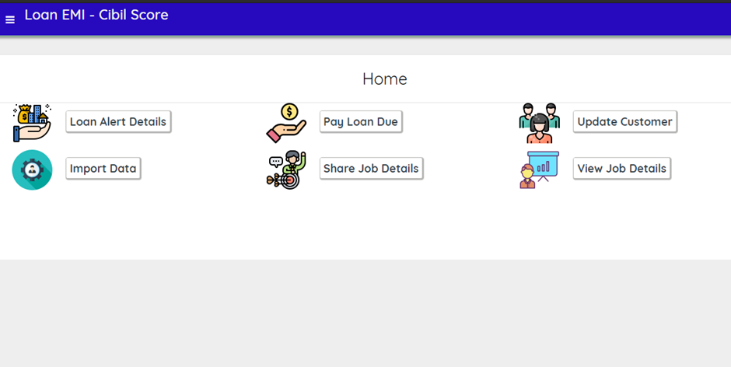

Slide 26
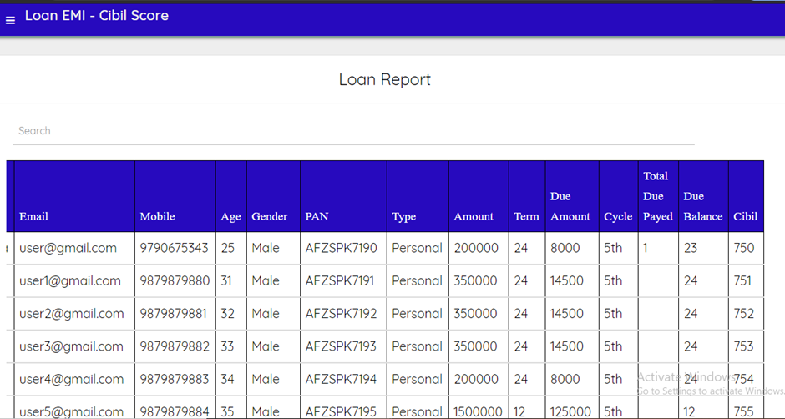

Slide 27
TEST CASES

Slide 28
FUNCTIONAL:
Test ID (#) | Test Scenario | Test Case | Execution Steps | Expected Outcome | Actual Outcome | Status | Remarks
1. | Verify User Registration number from India | Accept Valid Phone number | User clicks on User Registration link Enter the mobile Number on the text box Click Register button | User should be taken to the next page for entering more user login details | If the form details are valid,Then Registration will be successfull | working | success
2. | Verify User Login & Password | Don’t Process to next page till valid credentials | 1.User clicks on login 2.Fill the credentials. 3.Check for credentials 4.Login | User should be taken to the next page | If the credentials are incorrect ,then it Stays in login | pass | success

Slide 29
NON-FUNCTIONAL:
Test ID (#) | Test Scenario | Test Case | Execution Steps | Expected Outcome | Actual Outcome | Status | Remarks
1 | Security | 1 )Login ID. 2)Modifications. 3)Administra tor rights. | 1.Any users who make use of system to hold a Login ID and password. 2.Any modifications like insert, delete, update, etc. for the database can be synchronized quickly and executed only by the administrator. 3.The administrator can view as well as alternate information in the CIBIL System. | 1) Accept login id and pass word. 2)Modificat ion to be done 3)Changes to be done. | 1 )Accepted login id and password. Modifications are done Changes are done. | Working Pass Pass | In progress Success Success

Slide 30
2 | Reliability | Availability | The system is available all the time. | Availability | Available | pass | Success
3 | Maintain ability | 1) Back up is done. 2)Errors | 1]The system offers efficiency for data backup. 2The system will track every mistake and keep a log to it. | Back up should be done. Finding Errors. | 1)Backup is done. 2)Finding Errors successfully. | working | In progress

Slide 31
Defect Log :
Requirement # | Defect ID # | Defect Description | Assignee | Status
M1R1 | ID 1 | incorrect display on different resolution screens | B Sai natha | WORK IN PROCESS
M1R2 | ID 2 | An application consumes too much of the device’s resources | Chala jyothishwar | WORKING
M1R3 | ID 3 | The application isn’t launched in the first 5-10 sec | G Sai nadha | Success

Slide 32
2.Test Report:
Functional | Test Case Coverage (%) | Status
Module 1 | 60% | In-Progress
Module 2 | 60% | In-Progress
Module 3 | 55% | In-Progress
Category | Progress Against Plan | Status
Functional Testing | Green | Completed
Non-Functional Testing | Amber | In progress

Slide 33
GOAL:
S.No | Project Milestone | Expected Date
1 | 1000 users | Dec,2021
2 | 5000 users | Dec,2022
3 | 15000usres | Dec ,2023

Slide 34
CONCLUSION
In this paper, we presented the design and implementation of a CIBIL score alerts with Job recommendation, with which mobile users can get SMS notification if they did not pay their loan amount. In particular, users can get an idea of loan repayment strategy by the Job recommended by the system. So that even the financially helpless people will have the solution for their financial problem. It helps to maintain the good CIBIL score records for the users.

Slide 35

THANK YOU
RA1911003010914
RA1911003010912
RA1911003010916

